Slide 1
Proto Buffers

Slide 2
Data Serialization
Process of converting data objects present in complex data structures into a byte stream for storage, transfer and distribution purposes on physical devices.
Systems vary in hardware architecture, OS, addressing mechanisms. Internal binary representations of data also vary accordingly in every environment. Storing and exchanging data between such varying environments requires a platform-and-language-neutral data format that all systems understand.
Once the serialized data is transmitted from the source machine to the destination machine, the reverse process of creating objects from the byte sequence called deserialization is carried out. Reconstructed objects are clones of the original object.

Slide 3
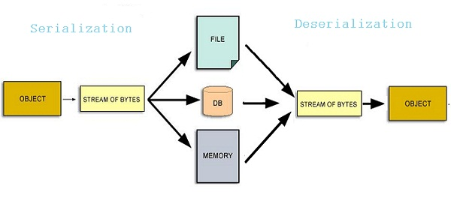
Data Serialization

Slide 4
Proto Buffers
Transmit Data
Lots of Data
Robusty
Fast

Slide 5
Options
XML- May be 10 years ago
CSV- Sounds good
JSON- Looks promising
Proto Buffers – Thrift

Slide 6
Formal Definition
Protocol Buffers are google’s language neutral, platform-neutral, extensible mechanism for serializing structured data for use in communication protocols, data storage and many more.

Slide 7
XML
XML is smaller, faster and simpler
Data is transmitted in compact binary format
Data is transmitted in compact binary format

Slide 8
How to Use Proto Buffers
Define how you want your data to be structured in .proto file.
Generate data access classes using protocol buffer compiler
Write and read data from verity of data streams in your application
Specify transport mechanism

Slide 9
Why Not XML or JSON
PBs are simple to transfer
3 to 10 times smaller
20 to 100 times faster
Less ambiguous
Generate Data access classes that are easier to use programmatically

Slide 10
File Format Representation
XML
69 Bytes
<person>
<name> John Dee </name>
<email>jdoe@example.com</email>
</person>
JSON
47 Bytes
person{
Name=“John Dee”
Email:”jdoe@example.com”
}
PB
28 Bytes
Binary data 0s and 1s uses base 128 variants

Slide 11
Sample .proto File
message person{
require string name = 1;
required int32 id = 2;
optional string email= 3;
enum PhoneType{
MOBILE=0;
Home=1;
Work=2;
}
message PhoneNumber{
required string number =1;
optional PhoneType type = 2[Default = HOME]
}
repeated PhoneNUmber phone=4;
}

Slide 12
Defining Message Types
Scalar Types
Message Name
message Person{
require string name = 1;
required int32 id = 2;
optional string email= 3;
}
Tags

Slide 13
Field Rules
Required- Message must have one of the field.
Optional – Message can have 0 or 1 field
Repeated – Message can have any number (including 0) in this field

Slide 14
Defining a Service
serive PersonService{
rpc getPersonByName(string) return Person;
}

Slide 15
What is Generated from your .proto File
Supports 3 languages
Java
C++
Python
For Java, the compiler generates a.java file with a class for each of message type. Special builder classes for creating message instance class
For C++ it generates .h and .cc files
For Python, a module with static descriptor for each message type. Which is used as metaclass to create a data access class at runtime

Slide 16
Other Options
Enumerations
Using other message Types(Instead of Scalar Types)
Nested Message
Comments
Extensions of Message

Slide 17
Base 128 variants
Methods of Serializing Integers
Smaller number take smaller number of Bytes
Each byte in a variant, except the last byte has the MSB set, to indicate further bytes to come
Lower 7bits of each byte store 2’s complement of the number in groups of bits, LSB first

Slide 18
Encoding
PB is series of key value pairs
Binary versions uses the field number as the key
The name and type is determined on the encoding end by looking at the .proto file
Key for each pair is two values – the field number from the .proto file and write type to find the length of the following values
(field_number << 3)write_type
Value is encoded using the Base invariant scheme

Slide 19
Example
message Test1{
required int32 a=1;
}
Set value of a = 150 in the application
Transmitted as 3 bytes 08 96 01

Slide 20
Understanding the Example
Message bytes 01 96 08
Encoding the key
Writetype of variant is 0. The tag of field is 1
Using (field<<3) write_type we get 000 1000 = 8
Decoding the value:
96 01 = 1001 0110 0000 0001
001 0110 0000 0001 (drop MSB)
000 0001 ++ 001 0110 (reverse the group of 7 bits)
10010110(conatenate)
128 + 16 + 4 + 2 = 150

